Slide 1


WebGIS Lab 7
DEBAYAN MANDAL

Slide 2

Lab Hours
Notes:
Please mail me before. Don’t wait till the submission date.

Slide 3
Learning Outcomes
2D Story Map
3D Story Map

Slide 4
What is ArcGIS Storymap?
ArcGIS Story Maps are web applications that let authors combine beautiful maps with narrative text, striking images, and multimedia, including video. They make it easy to harness the power of maps and geography to tell your story. The applications are designed to be attractive and usable by anyone, making them great for education and outreach, either to the general public or a specific audience. It is a simple yet powerful way to inform, engage, and inspire people with any story you want to tell that involves maps, places, locations, or geography.

Slide 5
Upload your data and beautify your map
Find out your favorite photos and upload them to ArcGIS online via the interface.
Link the location to each photo.
Make sure to fill in the information for each tab.
You may add multiple photos if needed. When finished uploading all the photos, don't forget to edit the title of your story map.
For the submission of this exercise, you may just use some simple photos (Minimum of 4) and share them with the organization. But later, you could create a new one to share with your family.

Slide 6
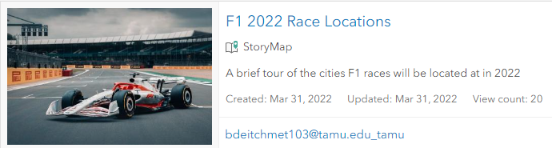
Define a theme of your storymap and prepare the data
Before developing your story map, let's brainstorm about the story's idea. Data used in the story map usually has something to do with locations. A good starting point is to use some traveling photos.
Example Story map (Created by Miss Bethany Deitch):
https://arcg.is/1ivO4b2

Slide 7
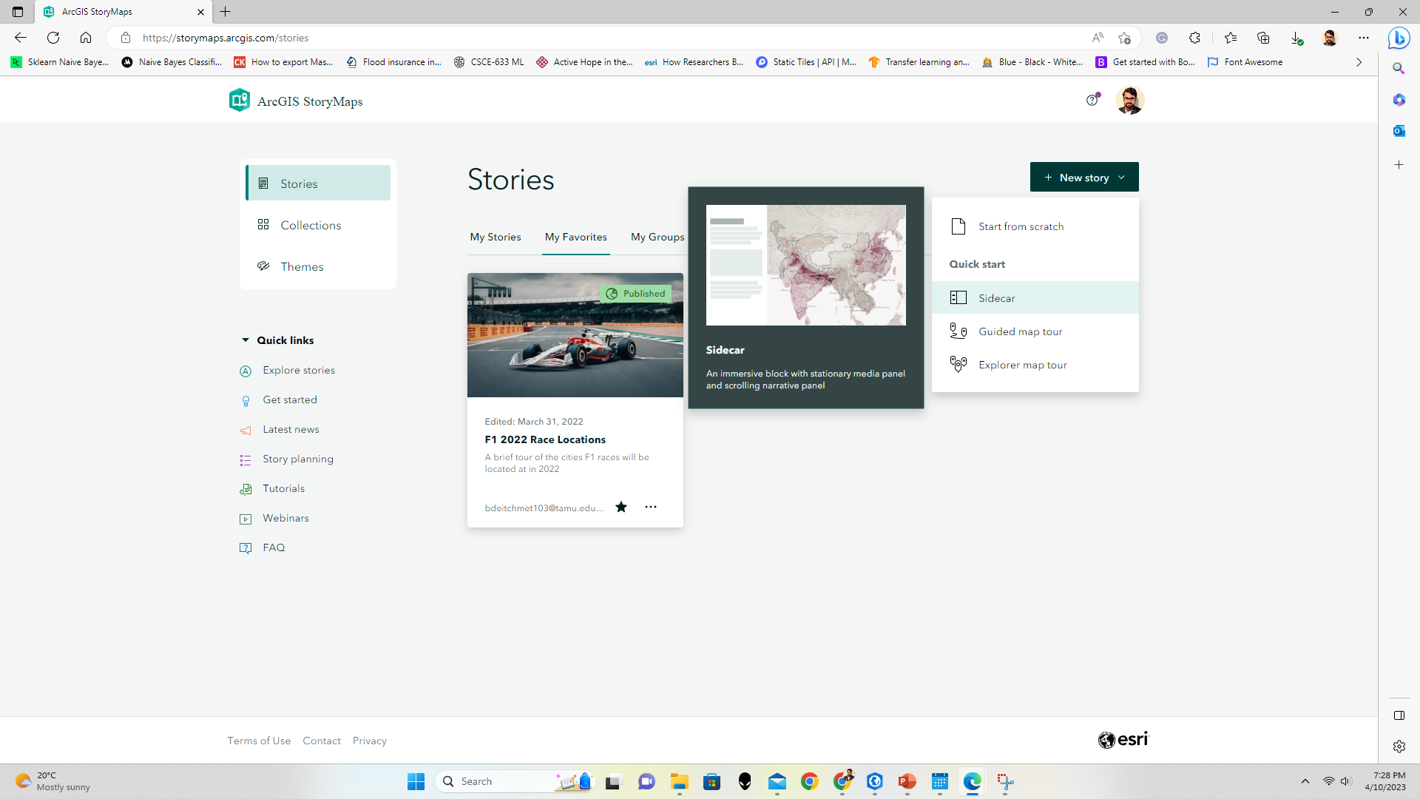
Sidecar is a scrolling, slide-based block that has three layout choices, each of which provides powerful narrative tools.
The floating panel layout is ideal for visually striking media with short captions or descriptions
The docked panel layout is optimal for longer narrative content, as it doesn’t overlap the media.
The slideshow layout is like the floating panel, but readers experience its slides laterally, rather than vertically, by manually clicking through them.
STEPS
New Story
Sidecar
Slideshow

Slide 8

Give a Title with a brief introduction
Add a cover image

Slide 9
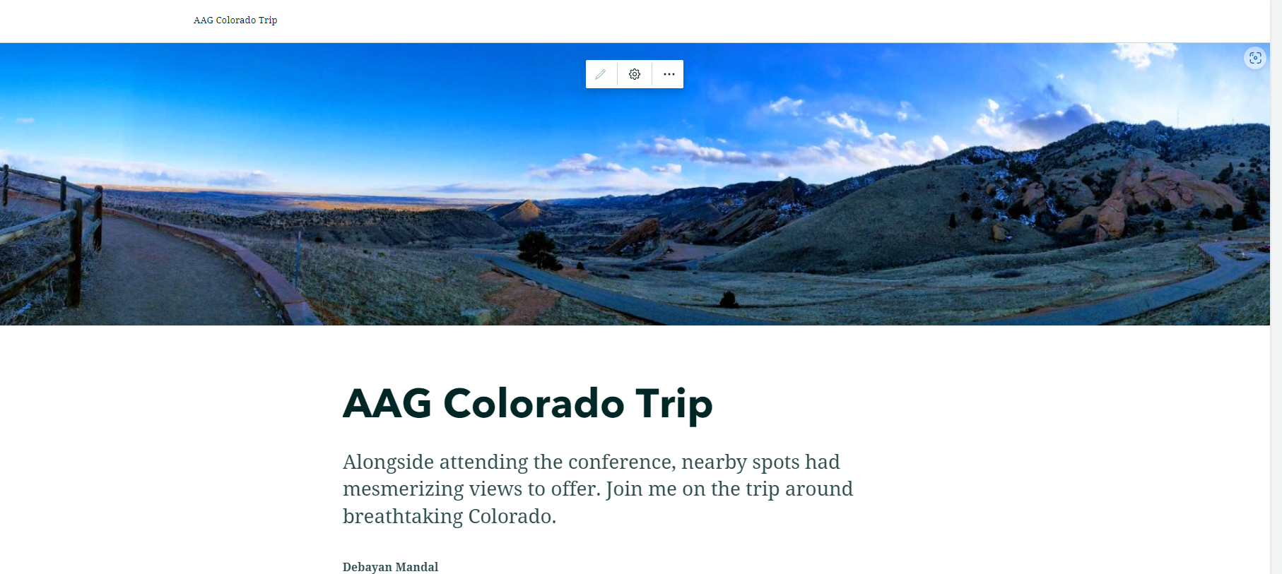

Slide 10
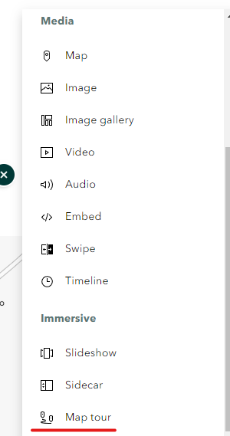
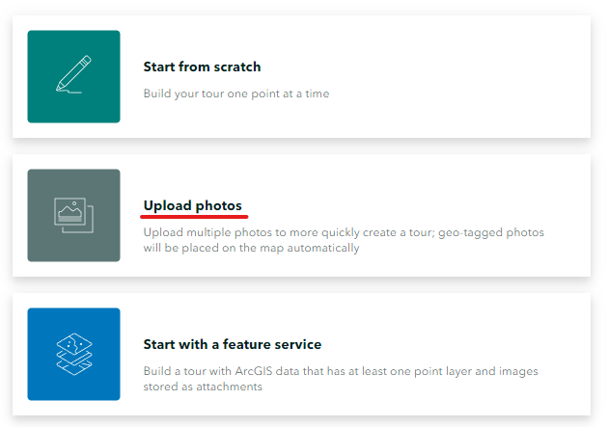
Let’s add a Map Tour

Slide 11
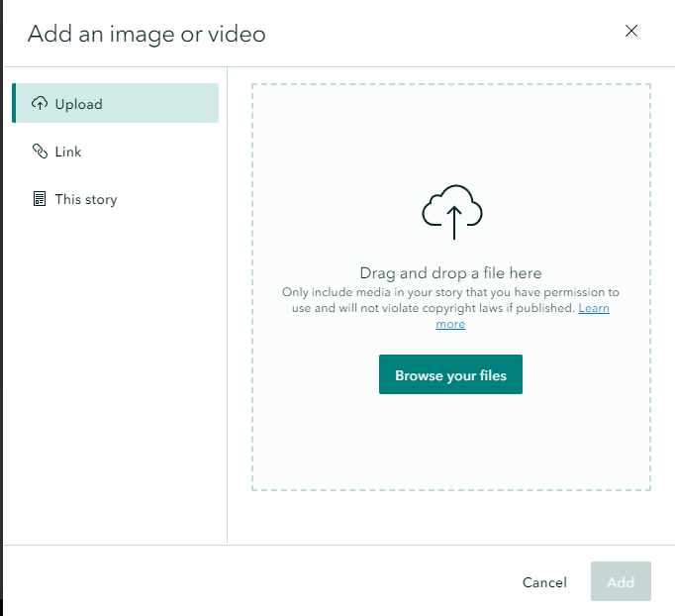
Upload the previously selected images or videos
If your image is geo-tagged, there will be no need to define a location
The images need to be lower than 10MB in size and 6000 pixels.

Slide 12
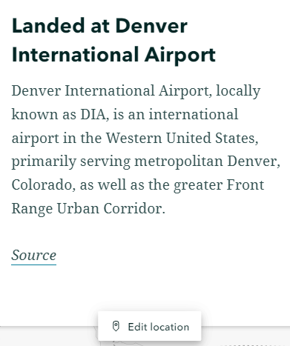
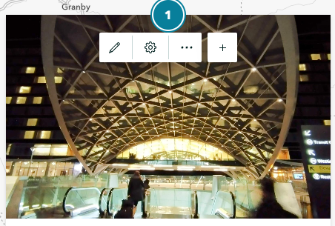
Map Tour

Slide 13
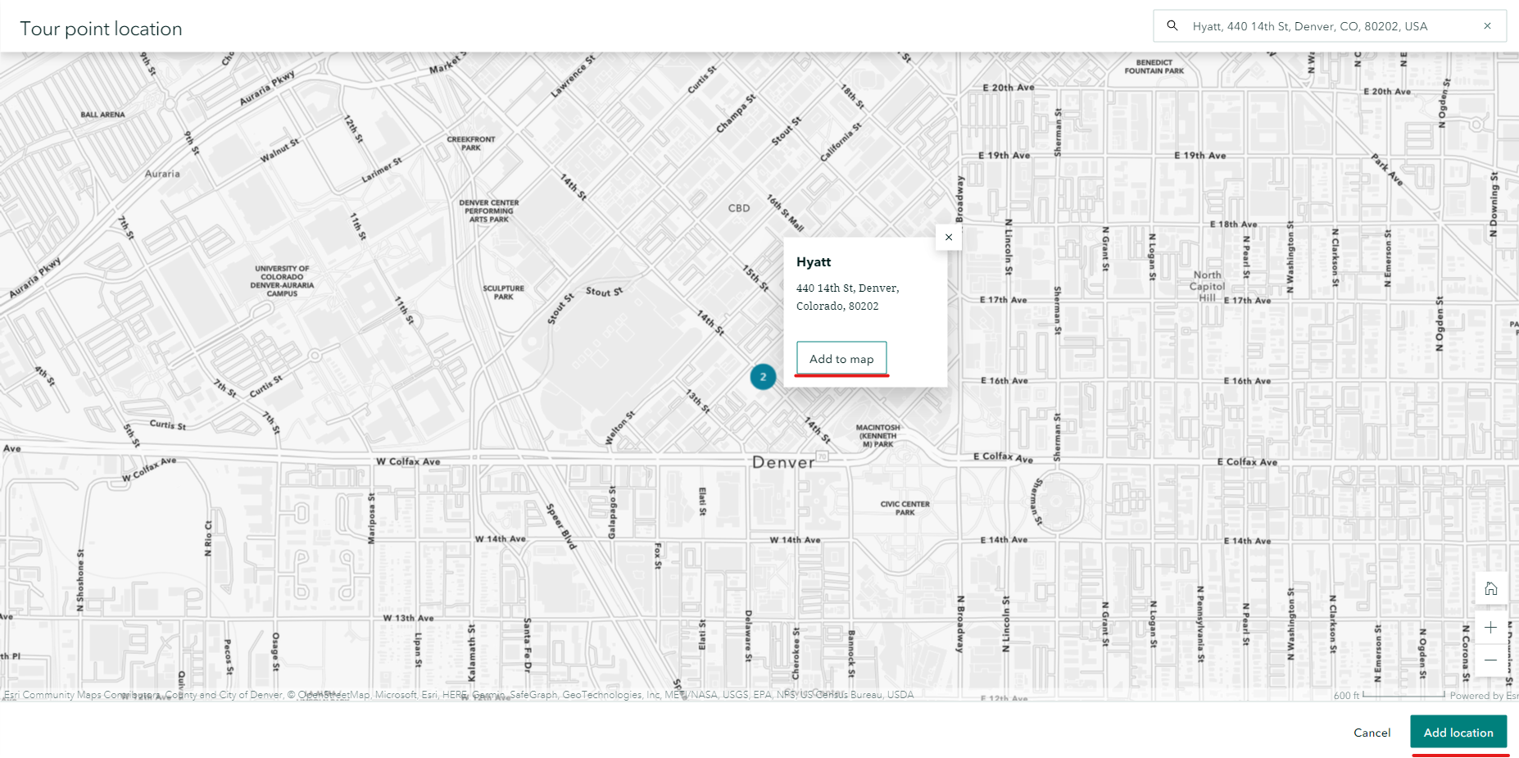
Adding Location if not Geotagged

Slide 14
Reorder and Add Information for all the Pictures

Slide 15
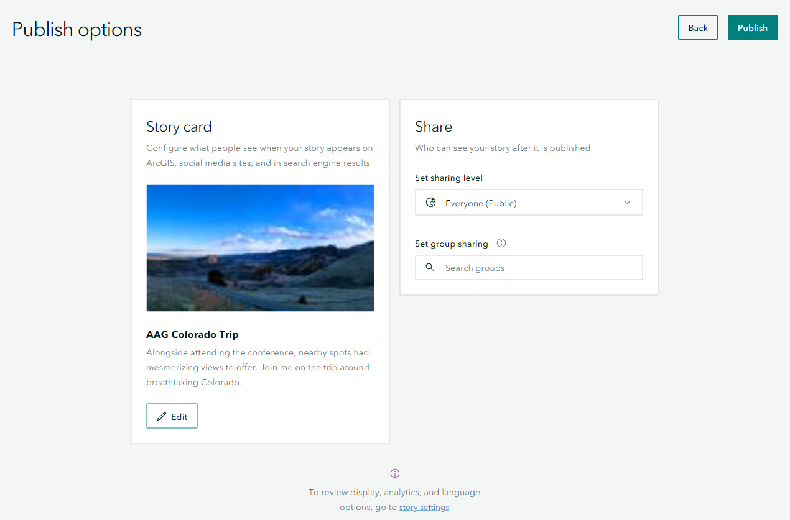
You may also set the sharing level to Organization if you so wish!

Slide 16
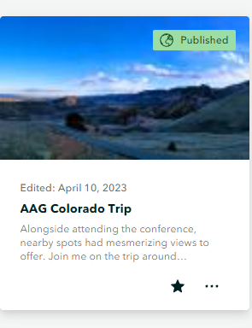
Final Look After Publishing:
My Story Map link:
https://arcg.is/1DjqfD0

Slide 17
Storymap with 3D map
Our world is 3D. So does your map. Esri has a 3D map rendering framework called Scene Viewer.
To embed the 3D layer with your story map, you need to link your story map to the Scene Viewer. One Example Layer has been provided to you. When you click the following links, make sure you click the "Open in Scene Viewer" button.
TAMU 3D building layer - http://tamu.maps.arcgis.com/home/item.html?id=6af9596e6a6542b8bd71df845763698e#overview
This was created in 2017. Shared by Dr. Daniel Goldberg.

Slide 18
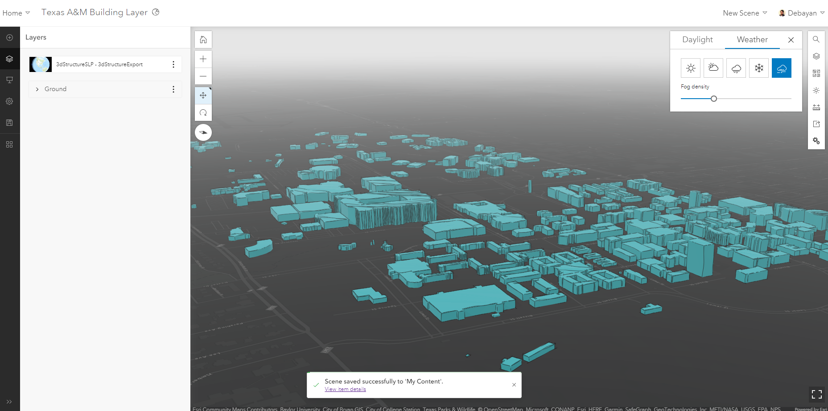
Save the View you would like to start with.

Slide 19
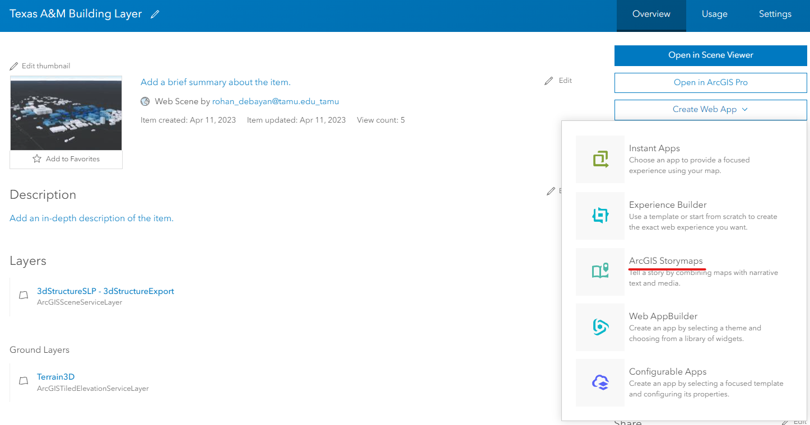
Click the name to get here. Create ArcGIS Story Maps.

Slide 20



Create a story title and give it a nice cover

Slide 21
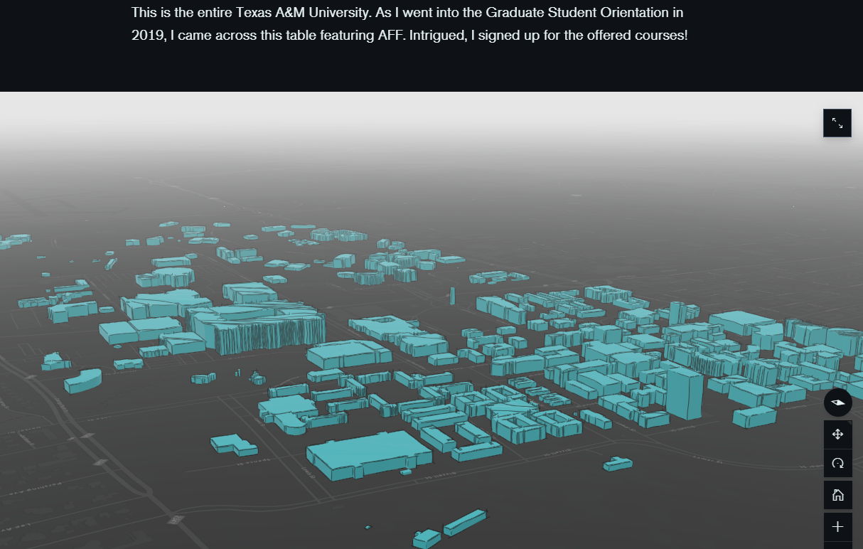
Start Your Story

Slide 22
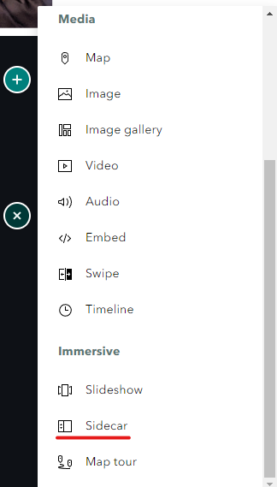
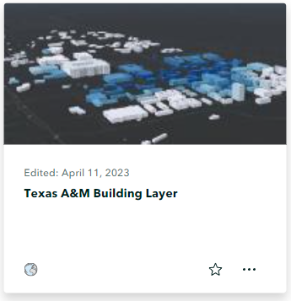
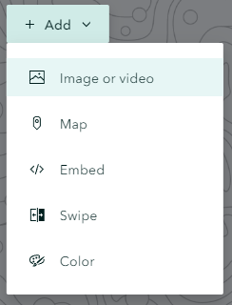
Use Sidecar/Slideshow

Slide 23
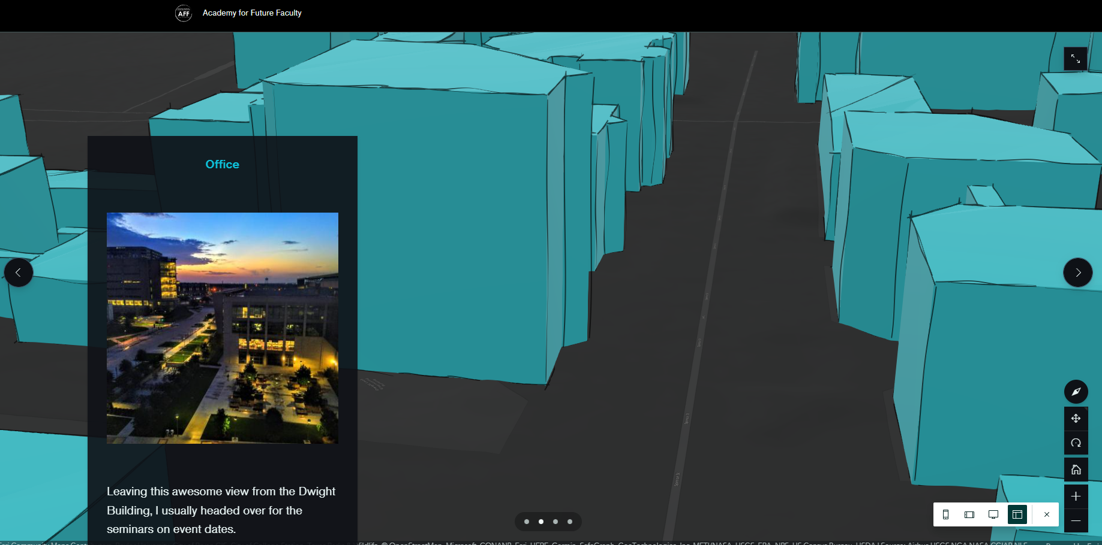
Set the display Duplicate Slide Change Orientation to where your story goes Transition is automatic

Slide 24
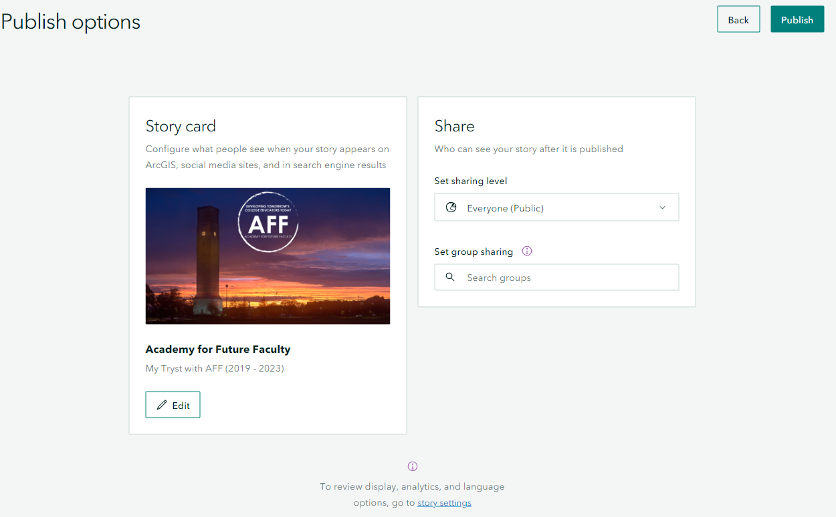
Final Steps
Feel Free to add as many images, texts, videos, and slidecars as you need to tell the story!
Publish this with the Everyone Setting On!

Slide 25

Final Look After Publishing:
My 3D Story Map link:
https://storymaps.arcgis.com/stories/fea647fed0c043ea9c7f445e3fa5bd6c

Slide 26
Task 1: Build your 2D story map 50pt
Decide the story you want to tell.
Find out the data you needed.
Follow the instruction to create your story map.

Slide 27
Task 2: Build your 3D web scene story map 50pt
Decide on what story you would like to talk about in the TAMU campus
Use the building layer to host the scene in ArcGIS online
Create a story map about your topic of TAMU campus which includes the 3D data layer as part of the story

Slide 28
To Hand In
GitHub - Open the story maps you created in a browser and take a screenshot for each of the sites and upload your screenshots & links (text file).
Two screenshots, and two links.
Canvas –
Submit your GitHub link.

Slide 29
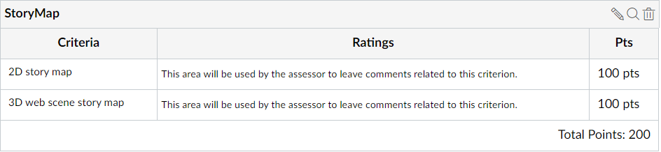
To Hand In
50
50
100
Notes:
All tasks, including labs, homework, and reports will have 5% point reduction for the late submission.

Slide 30
Thank You
Any Questions?

